Slide 1
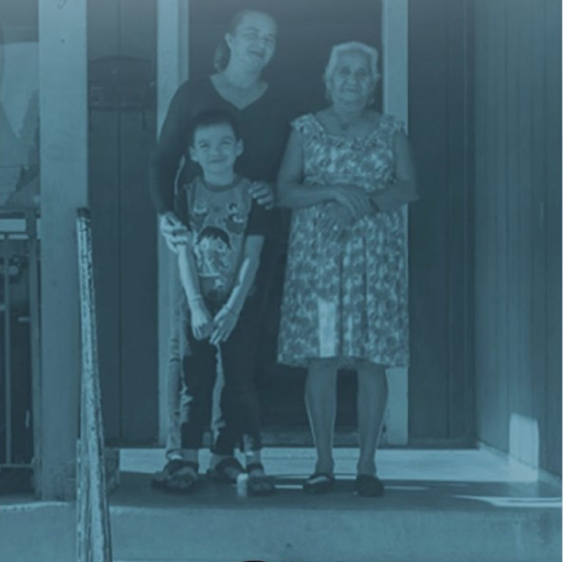
COVID-19 Collaborative
February 8, 2021

Slide 2
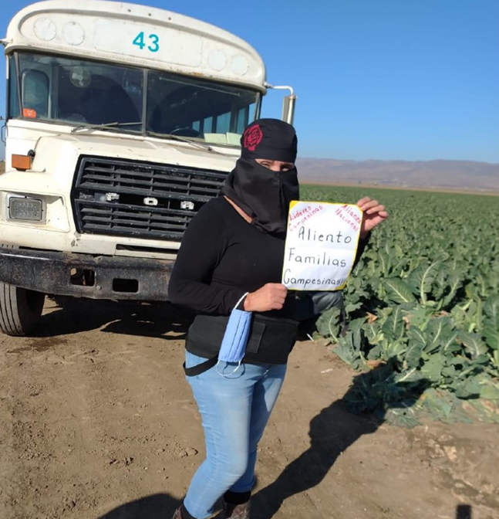
Why?
EQUITY
Covid-19 has exposed the inequities in our most vulnerable neighborhoods, namely the lack of health care and childcare, crowded housing, and the digital divide.
Covid-19 infections have thrived in large part due to crowded housing and economic insecurity that prevents proper quarantine by low wageworkers.
The CDPH’s Equity Metric to Fight COVID-19 makes clear the need to focus efforts on the communities disproportionately impacted by COVID-19 because of long-standing structural inequities.
Many have expressed the need for a coordinated effort aligned our shared outcomes.

Slide 3
November 20th Covid-19 Convening
CFMC convened a diverse group of leaders from the County, agriculture, community-based organizations, hospitality, healthcare, education, labor and philanthropy .
Over 80 participants joined the call and over 50 signed on to participate in the Covid-19 Collaborative
CFMC hired the Consensus Building Institute to support the coordination and structure of the collaborative.
Gina Bartlett is the lead consultant
She has many strong relationships in Monterey County
CFMC wants to enhance and build upon existing efforts.
County of Monterey
Monterey County Coalition on Agriculture
Grower-Shipper Association
COPA

Slide 4
COVID-19 Collaborative Purpose
Purpose: a countywide multi-sector collaboration of existing and needed efforts addressing COVID 19 and its impacts on our community and advancing a coordinated action plan driven by science and best practices in public health and equity.
The initiative will identify gaps and leverage resources to develop programs that will address the gaps.
The goal will be a reduction in the number of COVID-19 infections with priority in the disproportionately impacted Healthy Places Index (HPI) Census Tracts and ensure the health and well-being of our community.
Build from County’s Disparate Impact work.

Slide 5
Collaborative Structure
Outreach & Support Services
The Collaborative
Shared decision making
Made up of partners for implementation
Sets direction and negotiates action plan
Garners resources
Creates accountability for implementation
Evaluates data, adjusts, approach, continues
Communication and Marketing
Science & Best Practices Advisory Group
Partners
Communities
Interested Parties
Resources & Funding
Coordinating Committee
Vaccination Workgroup
Notes:
Collaborative Team
Made up of partners for implementation
Sets direction and negotiates action plan
Garners resources
Creates accountability for implementation
Evaluates data, adjusts, approach, continues
Meet every other week
Work Groups
Develop and carry forward detailed action plan / streams of work
Coordinating Committee
Helps plan Collaborative meetings
Partners
Implement action plan as agreed to in the Collaborative

Slide 6
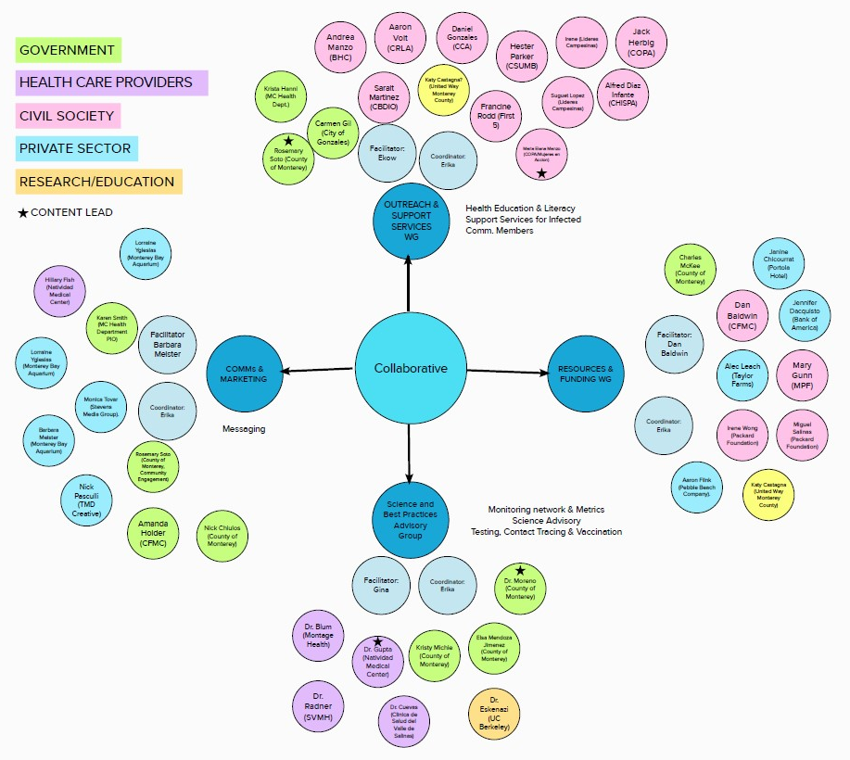

Slide 7
Outreach & Support Services
Purpose: To improve the systems of supports for residents to successfully quarantine and ensure there is accurate health education in the community to reduce the spread of the virus. The core strategy of this team is to implement a Community Health Worker (CHW) Model to help identify infectious people in the high-risk census tracts and get them the support they need to isolate/quarantine quickly and successfully. The model will work to identify necessary systemic changes so CHWs are quickly linked to people who have tested positive, streamline access to existing support services and identify gaps in service that interfere with successful isolation. Lastly, to improve the quality of information disseminated in the community around COVID-19 and vaccination.

Slide 8
Outcome
VIDA is a $4.9 million project funded by the County of Monterey to reduce the spread of the virus by identifying residents that are infected and use case management to identify needs and quickly connect them to resources residents need to successfully isolate/quarantine. VIDA will also support Covid-19 vaccination through education and outreach programs.

Slide 9
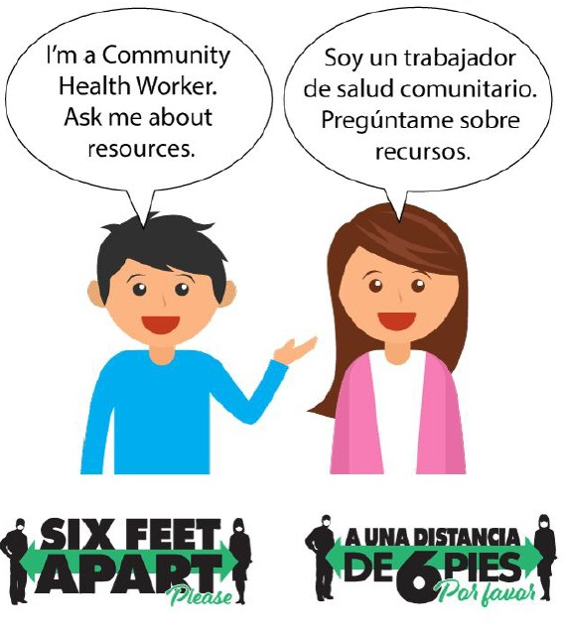
CFMC Role
CFMC is the fiscal agent of the funds distributed by the county.
CFMC will work in partnership with the County health department and County administrative office to coordinate and align the activities of the CHW’s.
CFMC will hire a project manager to lead various aspects of the work.

Slide 10
Communications & Marketing
Purpose: To build upon an existing communication framework to reach all residents of Monterey County, specifically those populations most disproportionately impacted by the spread of Covid-19. To nurture and create a united voice of many to amplify, enhance and optimize messaging to reduce the spread of COVID-19 throughout Monterey County, so, together, we achieve local public health and economic recovery goals.

Slide 11
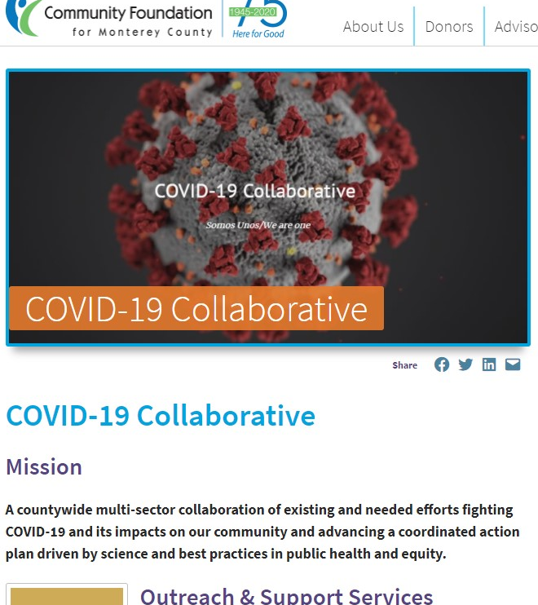
Outcomes
Vaccine Campaign led by Natividad Medical Center
CFMC hosts communications toolkit to amplifying existing messaging.
Development of targeted and effective messaging to reach vulnerable populations
An increase in knowledge of how to equitably provide resources and information to indigenous communities in Monterey County.
Development of marketing collateral for CHW’s.

Slide 12
Resources & Funding
Purpose: To identify existing resources and align funding to support the work groups. If needed, procure new sources of funding to support the work of the collaborative. In developing the work plan ensure resources are secured to move the work forward.

Slide 13
Outcomes
$300,000 grant from Public Health Institute to support CHW’s.
$186,000 from Monterey Peninsula Foundation for quarantine supports and vaccine coordination.
Potential funding from Packard to support vaccine coordination efforts and CHW’s.
Identify potential gaps related to quarantine supports, income replacement, vaccine distribution equity.

Slide 14
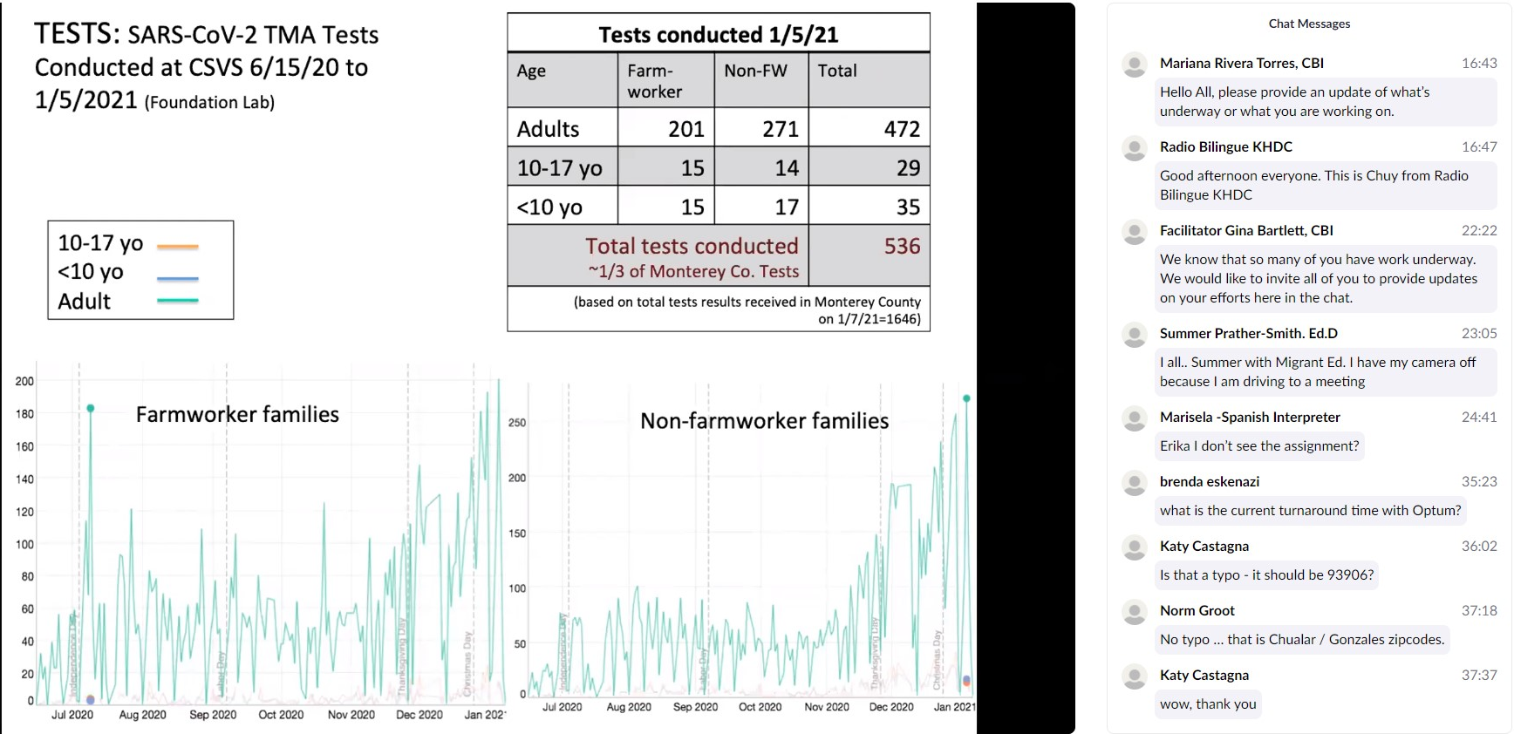
Additional workgroups
Vaccination workgroup
Coordinate operations to support the County in scaling up vaccinations as more vaccines become available by garnering and integrating community resources (equipment, skills, services, people). Review, refine, and implement best public health practices.
Science & Best Practices
Provide scientific leadership and a data-driven approach to drive the collaborative forward in 1.) reducing the rate of infection 2.) contact tracing and 3.) vaccination process. The goal is to utilize existing indicators and data to identify hot spots and areas that need additional capacity and interventions.

Slide 15
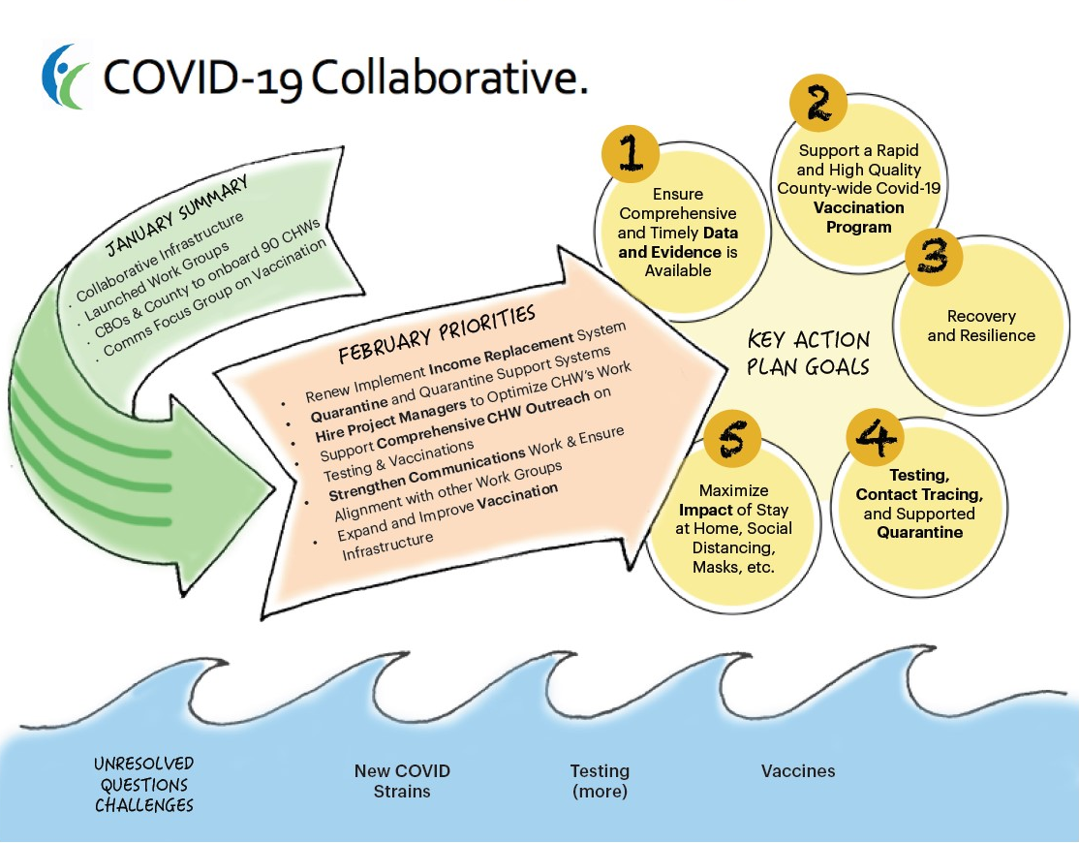

Slide 17
Questions?

