Slide 1

2017
Year In Review
CFMC Board Retreat
January 20, 2018

Slide 2
VISION & MISSION
Healthy, Safe, Vibrant Communities
To inspire philanthropy and
be a catalyst for strengthening communities throughout Monterey County

Slide 3
OUR VALUES
We advance positive change through grant making, community engagement and collaboration.
We build a legacy for future generations through responsible stewardship of the resources entrusted to us.
We operate with the highest standards of integrity, ethics and accountability.
We embrace inclusivity and diversity.
We commit to fairness and respect for the dignity of all people.
We are open and honest with our philanthropic partners, grantees and the community.
We strive for excellence in all that we do.

Slide 4
CFMC 2017 TRIVIA QUIZ
What were CFMC’s total assets as of 12/30/17?:
$2 $79 MM $264 MM $317 MM
How many new funds were opened?
  25 59 75 New funds, are you kidding?
What was the # of donors to MCGives!
Not enough! 2,237 4,725 Too many!
How many Facebook followers do we have?
11 2,501 5,034 100,402
What was the year the CFMC became a community foundation?
1789 1903 1981 1990 2025
*(Investment allocation not posted,
CRT & CGA not revalued, King gifts not included)

Slide 5
2017 TOP 10
10) Remarkable Year of Leadership
by Steve McGowan
  10a) Improved Financial Reporting at
  board meetings by Teri Belli
  10b) Investment Returns –14.3% (11/30)
9) Affordable Housing & Homelessness Work
8) COP, Legacy Society Luncheon,
Women’s Fund:
All broke records for attendance
7) CNE Brand 5 Year Anniversary;
Next Steps for Small Nonprofits

Slide 6
2017 TOP 10
6) Big Sur Relief Response
5) $4.87 Million Surpassed WOW!
Goal for MC Gives!
4) Launched Siembra Latinos Fund
3) Doubled Scholarship Growth
2) Gifts $47.58 Million (12/31)
Surpassed $264 in Total Assets*
1) Record Grants! $16.75 Million
(not including $1.7 MM interfund)
*(Investment allocation not posted, CRT & CGA not revalued, King gifts not included)
Notes:
LLA suggestion to add “Affordable Housing Work” somewhere on the list

Slide 7

COMMUNITY IMPACT 2017
Grantmaking
  More than $16.7 million granted
  Continuous improvement –
  online grant application process
  Next Steps for Small Nonprofits
  College Futures Monterey County
  Expanded involvement in
  community issues (homelessness)
  Responded to winter storm
  damage through Fire and
  Relief Funds

Slide 8
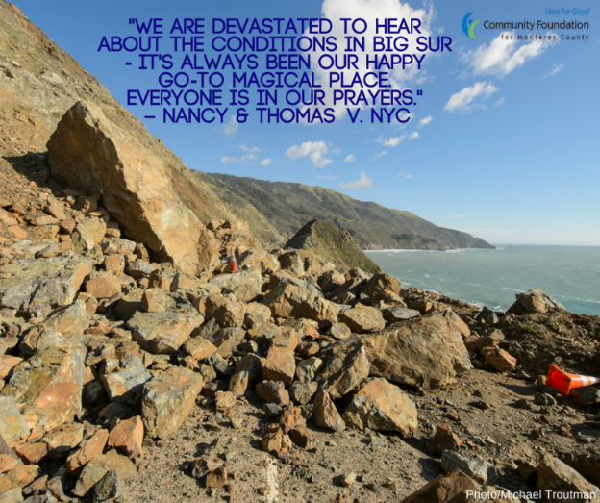
BIG SUR RELIEF &
SOBERANES FIRE FUNDS
$781,000 awarded in 2017
Notes:
Need to update chart.

Slide 9
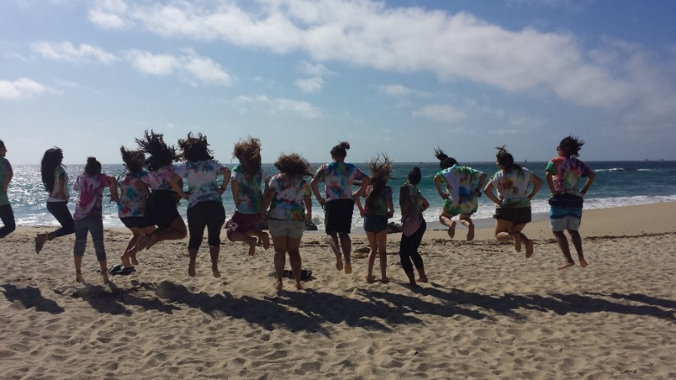

SCHOLARSHIPS
  Doubled the Number of Scholarships Awarded 225 Scholarships totaling $750,000 in 2017
  (up from 120 totaling $370,000 in 2016)
  Women’s Fund Awarded 35 scholarships to GHGH participants totaling $94,500
  (up from 15 totaling $68,250)

Slide 10
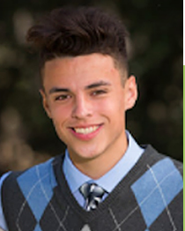

SCHOLARSHIPS - COLLEGE FUTURES
  Continued partnership with the College Futures Foundation and CSUMB to provide need-based scholarships to low-income, first generation students
2017: 65 Scholarships totaling $260,000
New online scholarship system
Over 500 students attended workshops in fall 2017
Received 3-year grant to fund advising in Greenfield and King City middle and high schools (Giannini Fund)

Slide 11
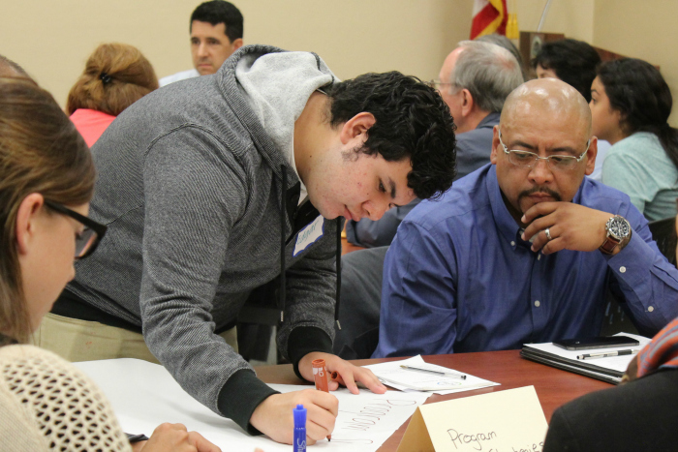
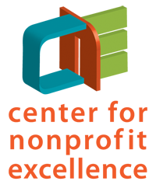
CENTER FOR NONPROFIT EXCELLENCE
  Served 201 organizations overall
  (39 had 3 or more contacts with CNE)
  220 people attended workshops
  Graduated 8th LEAD Institute and conducted LEAD Alumni research
  Convened nonprofits on immigration & deportation concerns
  Implemented CNE evaluation system, including 1st annual Nonprofit Survey

Slide 12
PHILANTHROPIC LEADERSHIP 2017
  $47.58 Million in gifts
  (including de Guigne gift of real estate)
  Facilitated $8,940,827 million in 831 grants from DAFs (including interfund transfers)
  Grew Legacy Society to 212 members
  Started 6 Charitable Remainder Trusts (CRTs)
  Started 4 Charitable Gift Annuities (CGAs)
  Increased number of complex gifts
  Grew relationships with other funding partners $1.52 million invested from private foundations

Slide 13
PHILANTHROPIC LEADERSHIP 2017
  Launched Siembra Latinos Fund
  Held 4 Donor Education Events
  DAF Co-Investment totaled $215,817 (20 funds)
  Joined National Center for Family Philanthropy
  Provided the CFMC Professional Advisor
  Council with philanthropic resources,
  education and stronger partnerships
  Implemented Carmel Realty Youth
  Philanthropy Initiative
  Record 59 new funds (vs 54 in 2016)
  $35 MM Growth in Expectancies to $223 MM

Slide 14
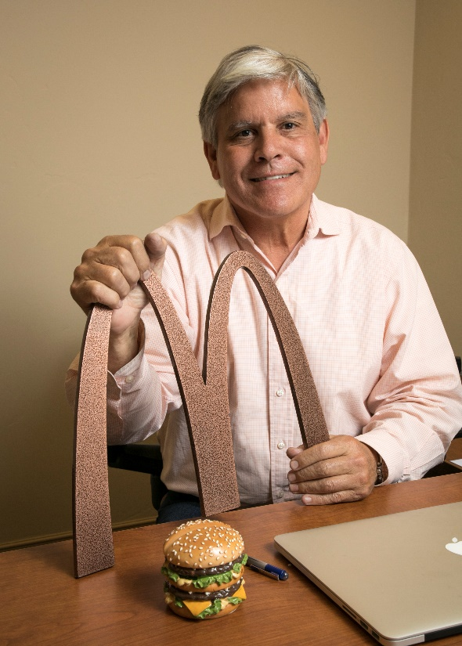
2017 NEW FUND BREAKDOWN
      Donor Advised: 32
      Agency: 7
      Scholarship: 7
      Designated: 2
      Field of Interest: 1
      General Endowment: 10
      2017: 59
      Total Funds: 495

Slide 15


MONTEREY COUNTY GIVES! 2017
  Record $4.87 million raised
  increase of 32% ($3.65 million in 2017)
  Record match - $450,000 up from 350,010
  Record challenge grants – $850,173
  increase of 80% ($471,642 in 2017)
  Record 4,725 donors

Slide 16
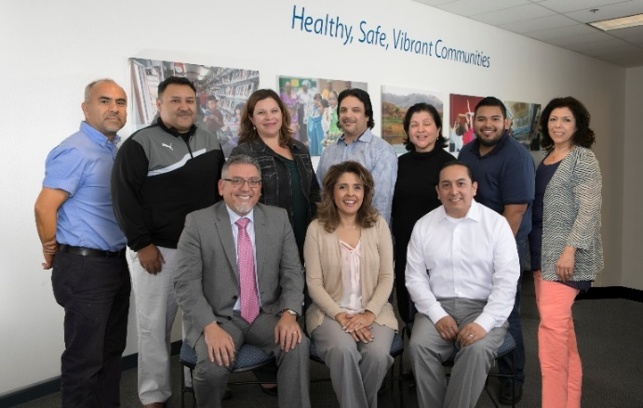
AFFILIATE FUNDS 2017
  Created Siembra Latinos Fund
    Established Advisory Board
    $47,250 raised
  Northern Monterey County Foundation
    Granted 24,000 in first year of grantmaking
    $251,000 raised/pledged through 2017
  Southern Monterey County Foundation
    Granted $20,000
    Granted over $72K since 2014
    $257,600 raised/pledged through 2017

Slide 17
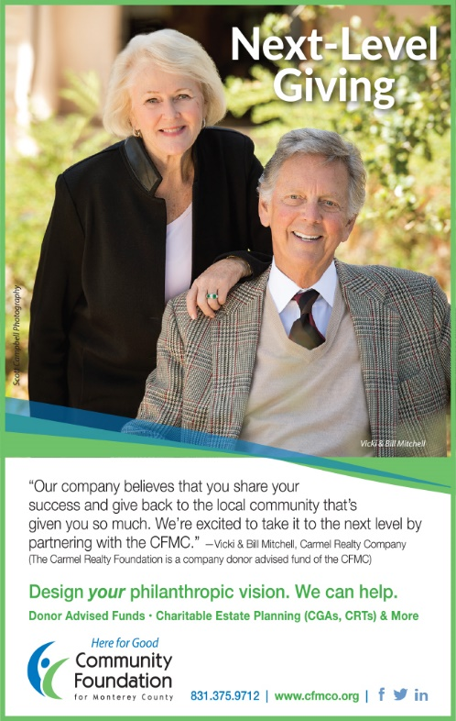
COMMUNICATIONS 2017
  Put a “Face on Philanthropy” through ad campaign featuring donor advisors
  Stronger blog and content schedule
  Social media growth – hit 2,500 fans
  Big Sur Relief social media
  response
  New Planned Giving Guide
  Updated Marketing Materials

Slide 18

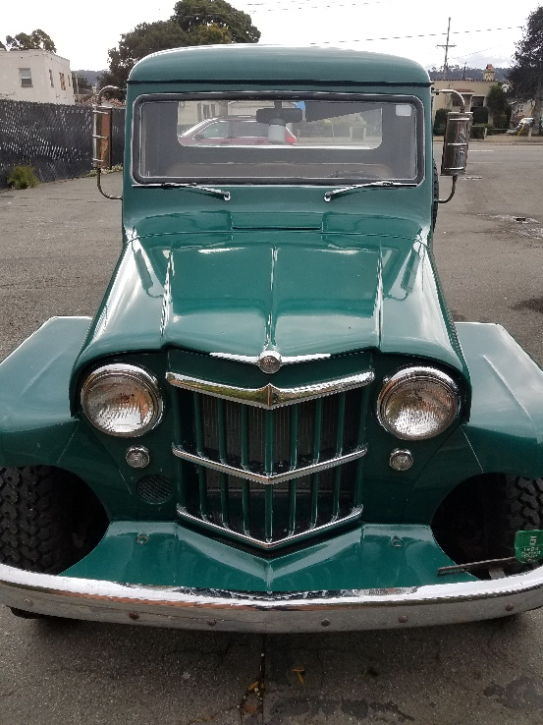
ORGANIZATIONAL EXCELLENCE 2017
Finance/Investment/Stewardship
Clean Audit
Reconfirmed Compliance for
National Standards
Dental & Vision Insurance
Plan Upgrade
Increase in Recording
of Complex Gifts

Slide 19

TECHNOLOGY 2017
  Upgraded operating system to Windows 10
  Installed standing desks
  Replaced 5 computers
  Enhanced security software
  Tech Team and ATG – Evaluates and plans for 2018 transition to cloud

Slide 20
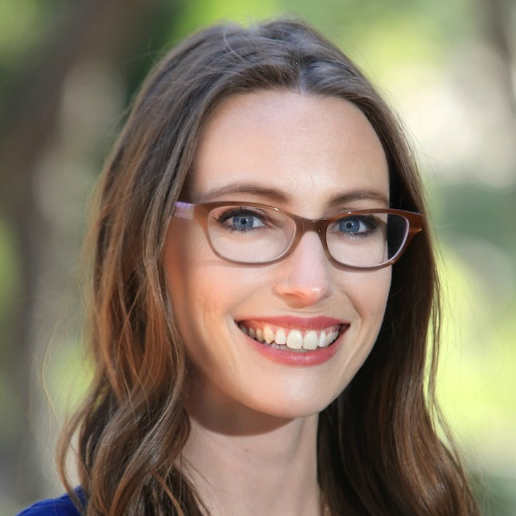
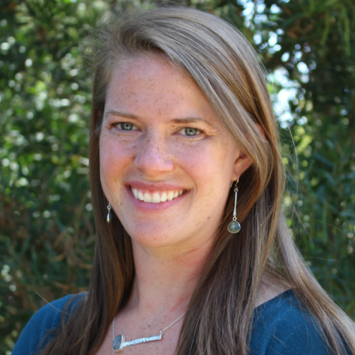
ADMINISTRATION 2017
  Nimble response to high volume of transactions for Women’s Fund, Big Sur
  Relief, MC Gives checks
  Key staff Additions: Mackenzie & Minnie
  Implemented new MC GIVES accounting process
  Streamlined DA letter
  document retention,
  saving time and paper

Slide 21
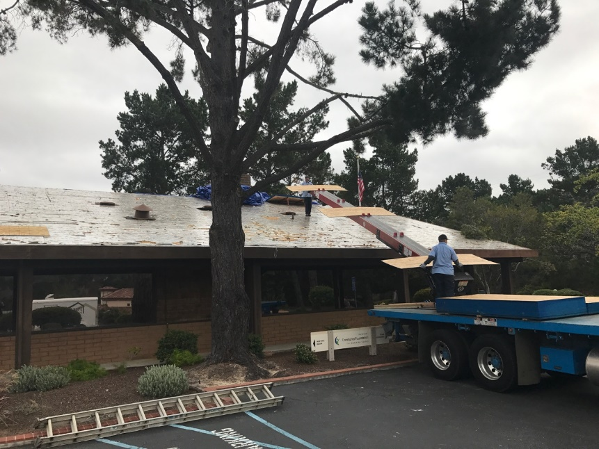
ORGANIZATIONAL EXCELLENCE 2017
  Installed new roof Garden Road
  Green Team continued to improve
  carbon footprint awareness and practices
    Recycling, reusable containers, paper reduction

Slide 22
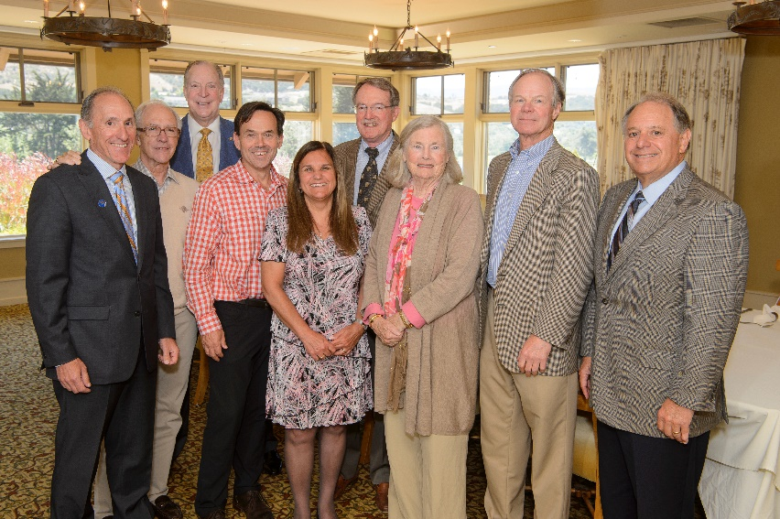
BOARD DEVELOPMENT 2017
  Michael Reid, Loren Steck,
  Abby Taylor-Silva, Jan Vanderbilt,
  and Maija West join board
  Held 6th Annual
  Past Chairs’ Luncheon
  4 board members (and 2 staff)
  attended Council on
  Foundations
  Fundamentals Course

Slide 23
COMMUNITY LEADERSHIP 2017
  Affordable Housing
    Convened city, county and nonprofit stakeholders to develop shared vision
  Homelessness
    CEO became part of Leadership Council for 10-year plan to end homelessness
    VP Grants & Programs continued work with Chinatown portal committee

Slide 24
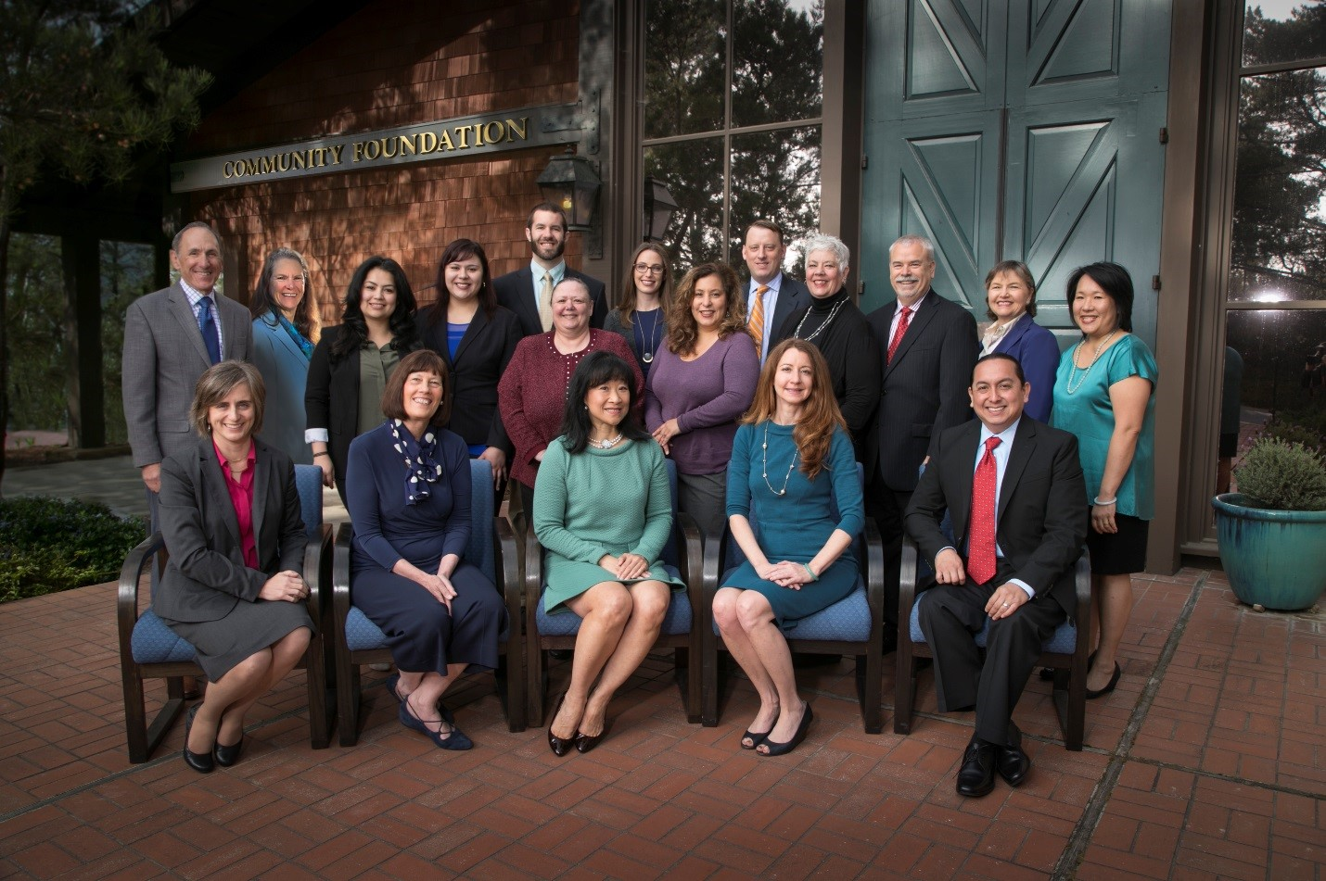
CFMC - HERE FOR GOOD 2017

Slide 25
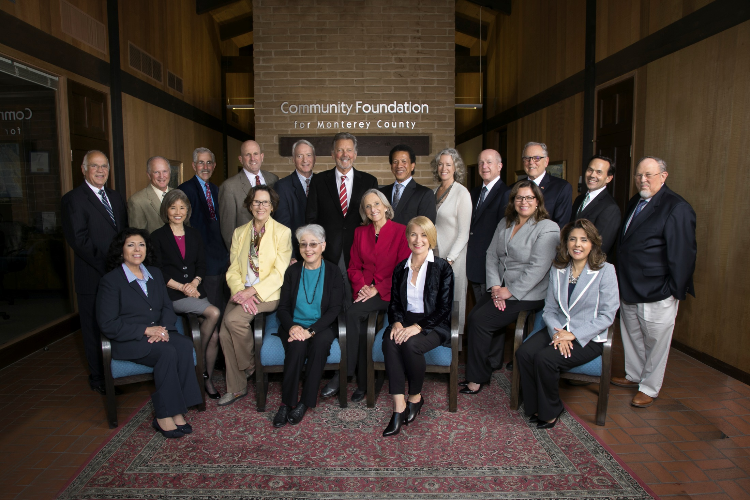
CFMC - HERE FOR GOOD 2017

Slide 26


Slide 27


