Slide 1

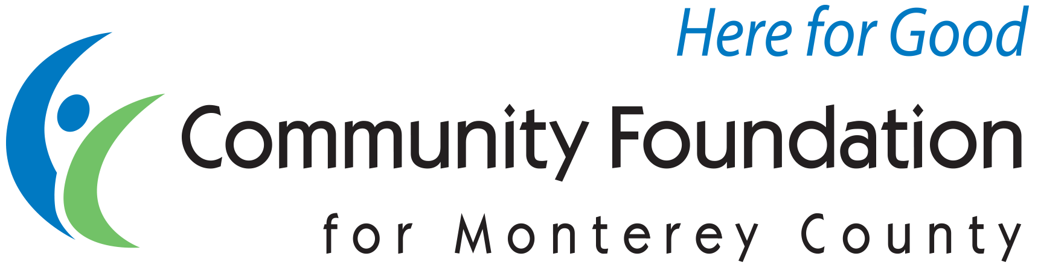

Alphabet Soup:
CRATs, CRUTs, CGAs & DAFs
CFMC Board Retreat 2018

Slide 2

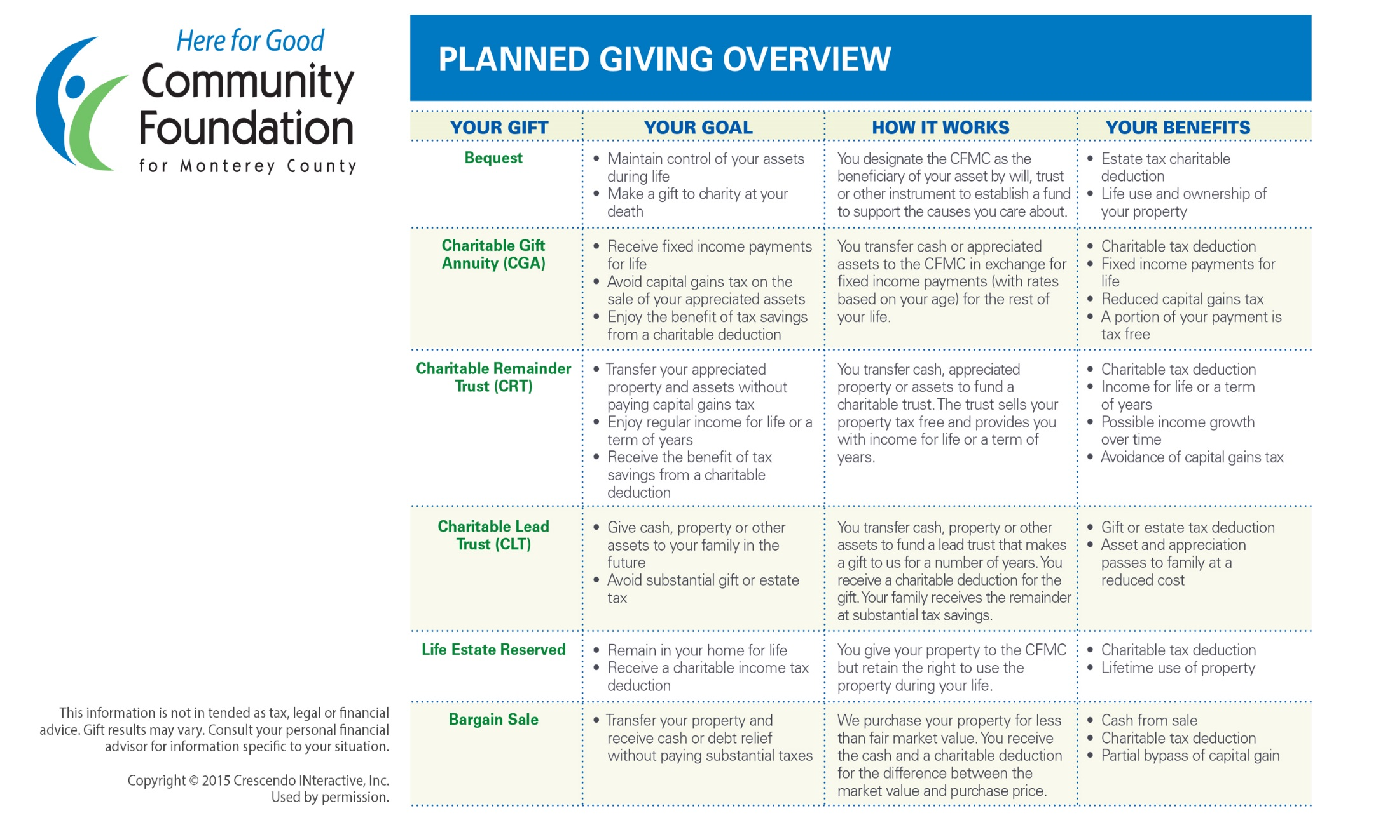
Planned Giving

Slide 3

Gifts that Give Back
Charitable Gift Annuities
(CGAs)
Charitable Remainder Trusts
(CRTs)
Notes:
1,171,986 in coinvestmetn
469,102 Community Impact
270,000 Food Bank Fire
432,884 Monterey County gives!
$1,171,986

Slide 4

Charitable Gift Annuity
A charitable gift annuity allows donors to make a gift to the CFMC and benefit the nonprofit(s) of their choice.
Established with a contract with the CFMC
Immediate tax deduction for charitable portion of the gift
Stream of income that is fixed for life
A portion of the income may be tax free
TIAA Kaspick handles all administrative details
Upon the donor’s death, the remainder creates an endowed fund at the CFMC to fulfill the donor’s charitable wishes
Does not require the assistance of an attorney

Slide 5

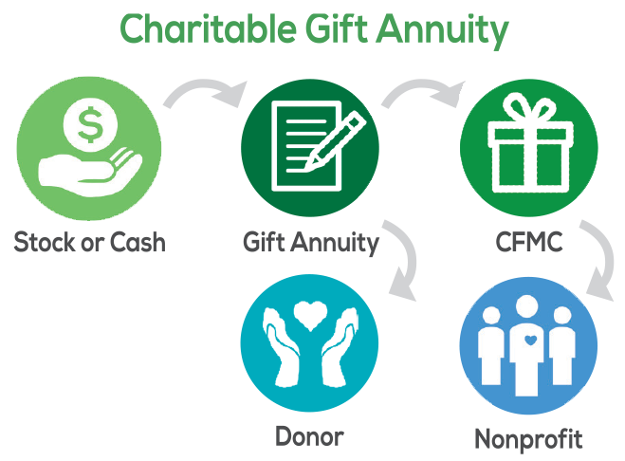

Slide 6

Charitable Gift Annuities
Example Donor Ages & Rates
Age | Rate of Return
65 | 4.7%
70 | 5.1%
75 | 5.8%
80 | 6.8%
85 | 7.8%
90+ | 9.0%

Slide 7
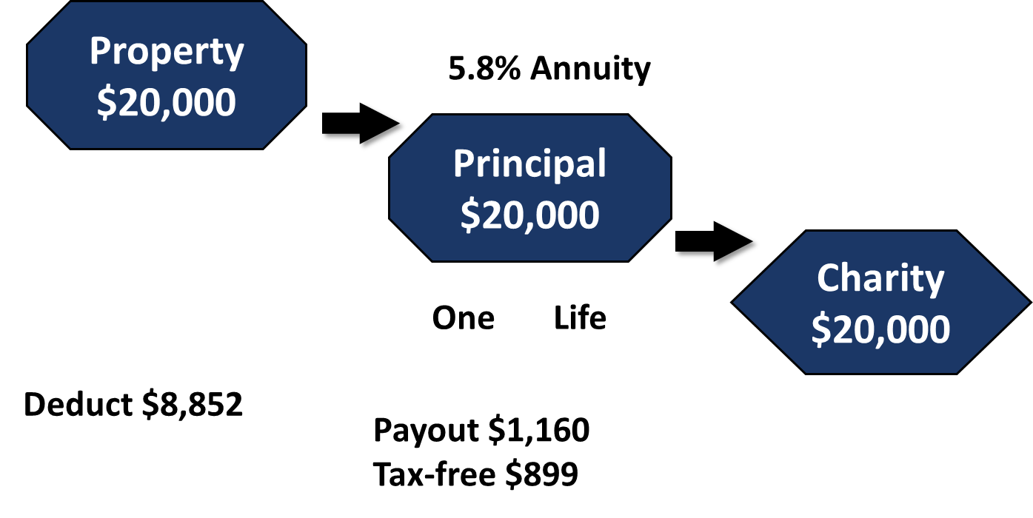

Sample Charitable Gift Annuity
Susan Green – Age 75

Slide 8

Charitable Remainder Trusts
Annuity
(CRAT)
Unitrust
(CRUT)

Slide 9
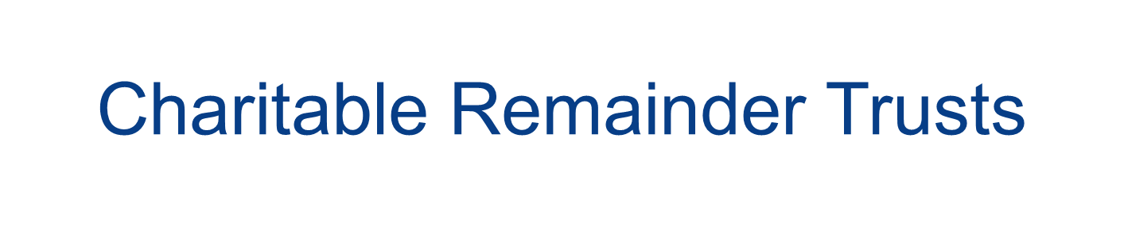
A CRT is a vehicle into which donors can place assets and in return receive income. The remainder ultimately benefits the causes of the donor’s choice.
CRT is its own legal entity, requiring an attorney to establish
Donors can give cash, appreciated stock, closely held stock, real estate or other assets. Real estate must be free and clear.
Avoid capital gains tax and receive a charitable income tax deduction
Donors receive a stream of income during their lifetime, a portion of which may be tax free. Payments may be fixed (CRAT) or variable (CRUT). The minimum annual percentage payout is 5%.
Donor decides how they want the remainder to be used to benefit the nonprofit of their choice
For CFMC to trustee, 25% of the remainder must stay with the CFMC in an endowed fund
Administration and investment is handled by TIAA Kaspick

Slide 10
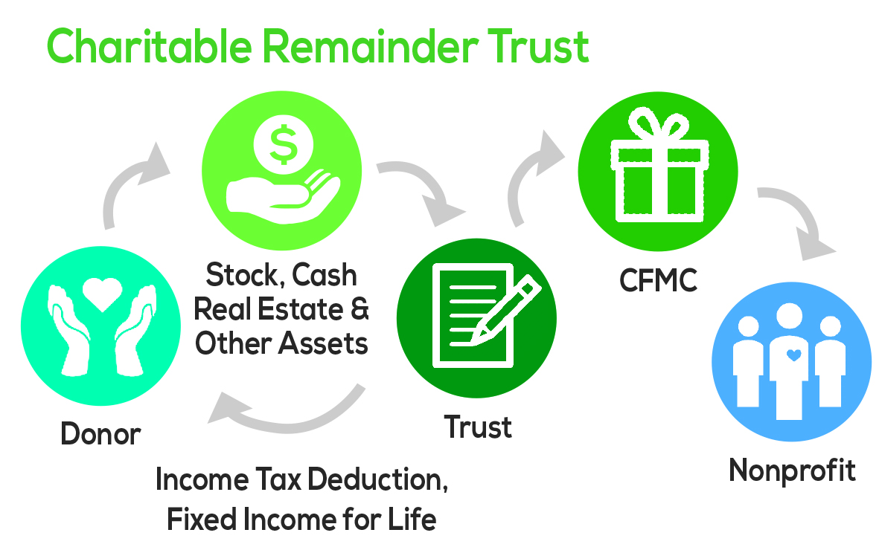
Charitable Re
March 2, 2016

Slide 11
CRT vs. CGA
Charitable Remainder Trusts | Charitable Gift Annuities
CRT Requires an attorney | Donor sets up CGA directly with CFMC
CRT is its own legal entity | CGA is backed by assets of the CFMC
Donor retains control over how assets are invested | CFMC invests the assets
Donor can set the payout rate (>5%) | Payout rate is based on donor age
Donor can select multiple income beneficiaries | Donor is limited to two annuitants
Trust assets could be exhausted | CFMC must pay for life even if underlying assets are exhausted
25% of remainder must stay at CFMC | 100% of the remainder stays at CFMC

Slide 12
Donor Advised Funds
Discover the Value of Partnering with the Community Foundation for Monterey County

Slide 13
CFMC Donor Advised Fund
Involvement, Control, and Family Continuity
You make a tax deductible gift to create a donor advised fund and recommend grants to qualified nonprofit groups. Receive immediate tax benefits in the year the gift is made. You can add to your fund anytime. Can utilize a wide variety of assets (such as cash, appreciated stock, real estate or other assets). Can involve multiple generations

Slide 14
CFMC Donor Advised Fund
Tax Status
Public charity Benefits from CFMC’s 501(c)3 nonprofit status

Slide 15
Tax Deductions
CFMC Donor Advised Fund | Private Foundation
Up to 50% of adjusted gross income on cash Up to 30% on appreciated stock Up to 30% on real estate and closely held stock | Up to 30% of adjusted gross income on cash Up to 20% on appreciated stock Up to 20% on real estate and closely held stock

Slide 16
CFMC Donor Advised Fund
Grantmaking Support
Professional philanthropic services staff with local expertise grantmaking support research verification of nonprofit status accounting services marketing

Slide 17
CFMC Donor Advised Fund
No startup costs
No minimum payout requirements
Easy to establish
$5,000 minimum (non-endowed) $25,000 minimum (endowed)

Slide 18
CFMC Donor Advised Fund
Administration
CFMC handles all administration and reporting. Donors have access to their fund on-line via Donor Central and receive quarterly fund statements. Privacy: All tax and financial information is private. Donors may remain anonymous if preferred.

Slide 19
CFMC Donor Advised Fund
Investment Options
Four investment options to help fund holders achieve their philanthropic goals. Added advantage of pooling funds together for greater diversification of investments, which provides for more opportunities for growth while reducing risk and lowering fees. May invest with CFMC portfolio or select outside managers.

Slide 20
CFMC Donor Advised Fund
Estate Planning
Vehicle to leave a legacy through a planned gift

Slide 21
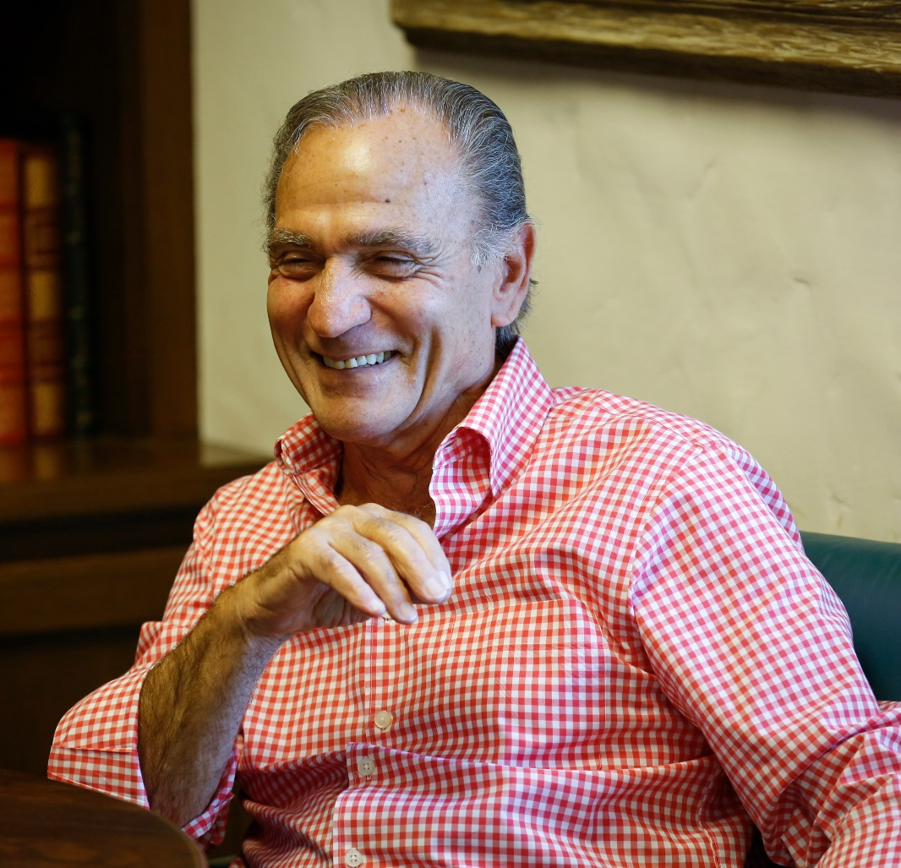
“I chose to utilize the Community Foundation because of the high level of support I receive. I don’t have the administrative burden of a private foundation now and I’m confident my wishes will be carried out in the future.”
-Bob Nunes

